Slide 1
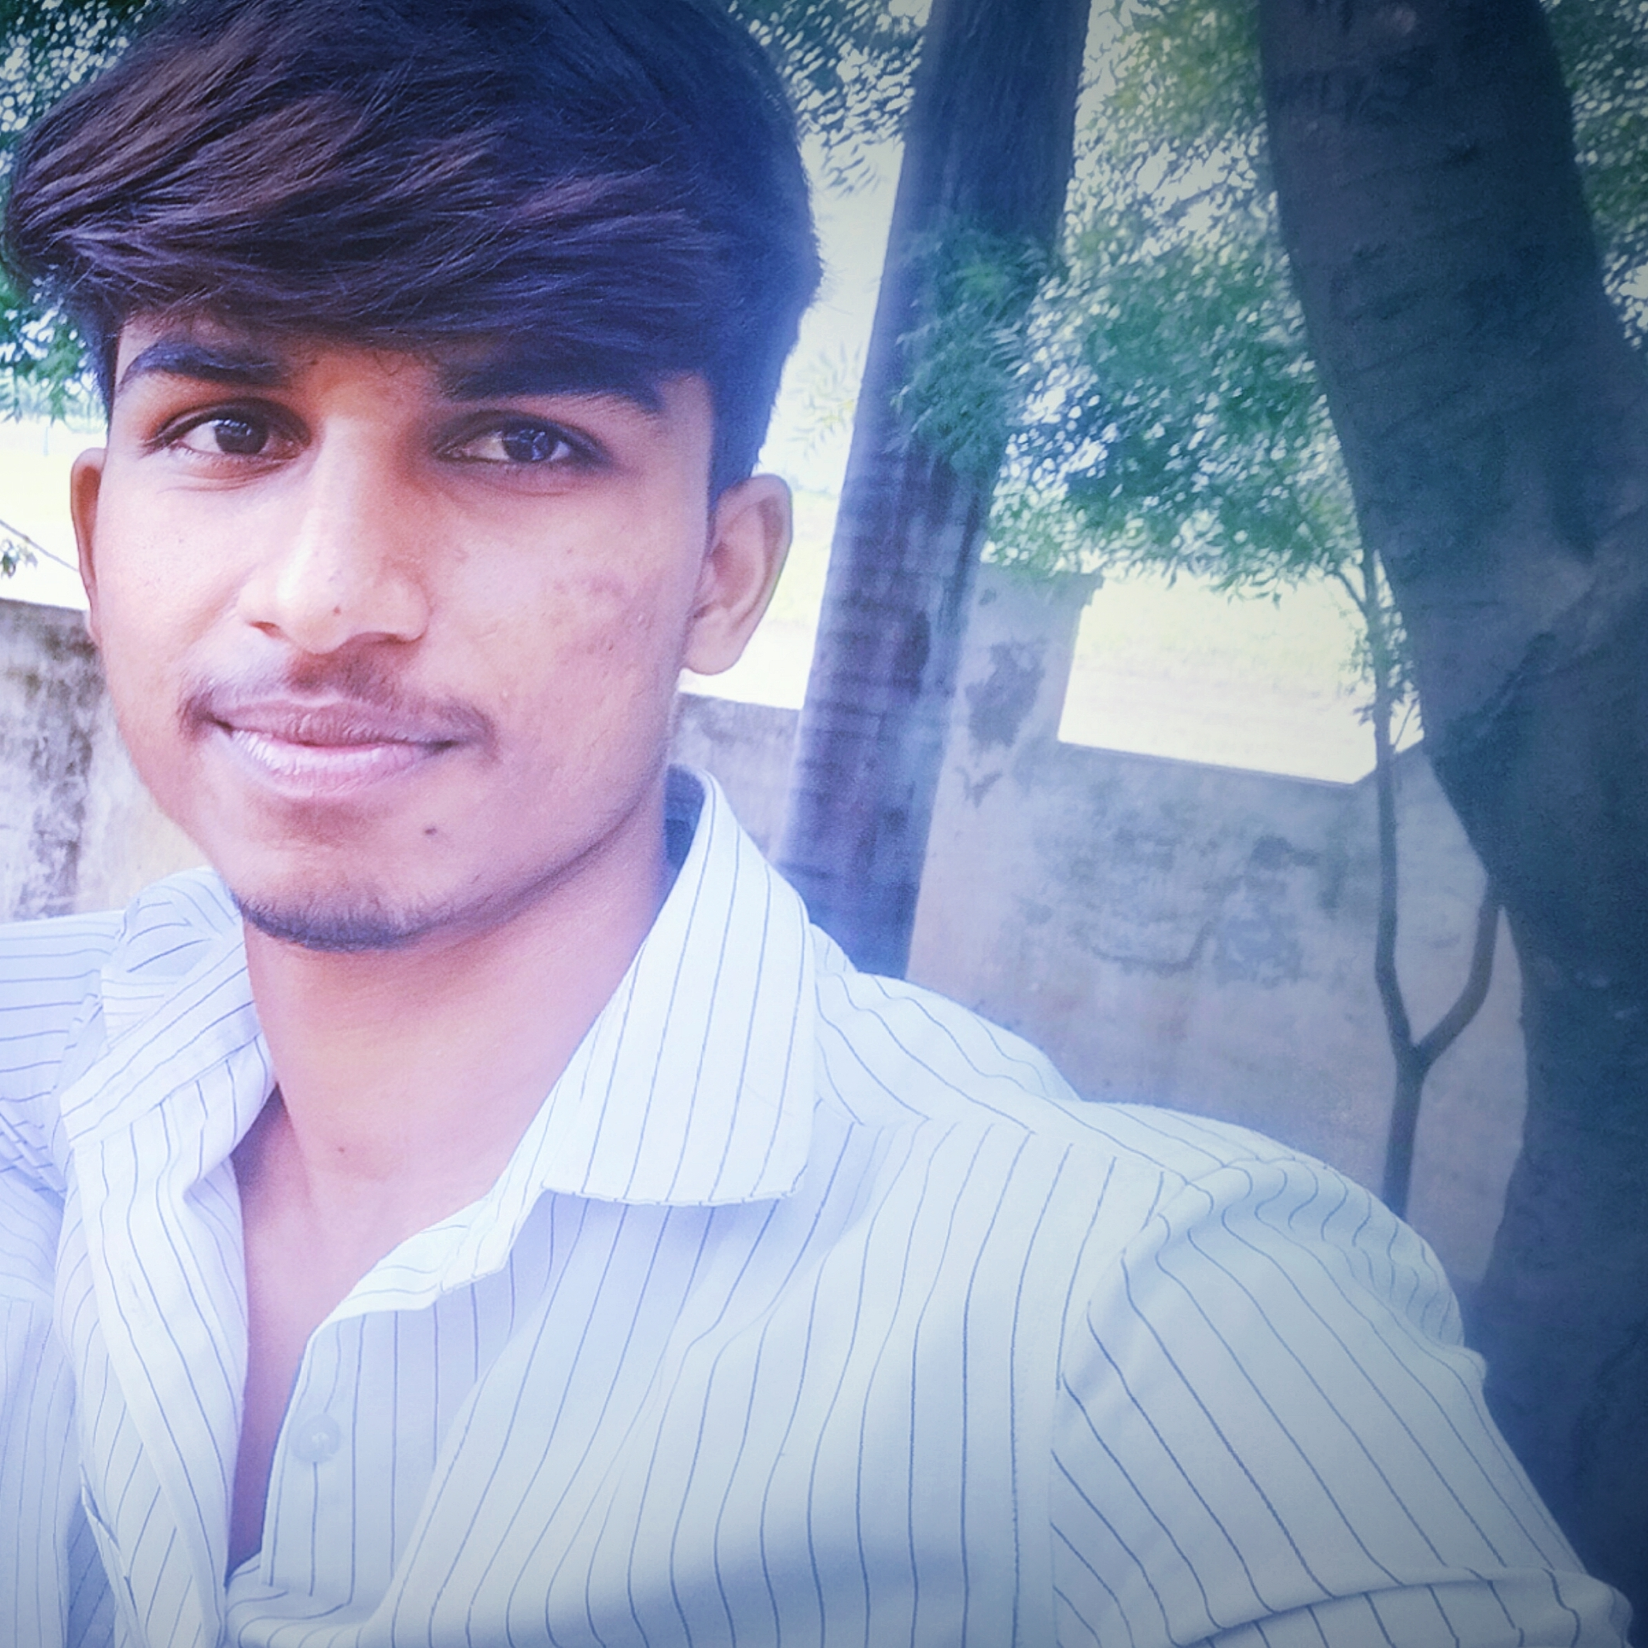

STUDENT DETAILS:
NAME :C.Rohith prakash reddy
k BUILD EMAIL ID rohithreddy.515110@gmail.com
COLLEGE NAME : SIR C.V.RAMAN INSTITUTE OF TECHNOLOGY AND SCIENCES
COLLEGE STATE : ANDHRA PRADESH
INTERNSHIP DOMAIN : DATA ANALYTICS
INTERNSHIP START & END DATE : 05-06-2023 & 23-07-2023

Slide 2
DOCTOR VISIT ANALYSIS USING PYTHON

Slide 3
PROBLEM STATEMENT:
The problem statement of my project is doctor visit analysis that is based on their age and other factors how many patients are visited a doctor to cure their diseases.
The data contains of income , gender, age, illness, reduced and some other factors.
So in this project I am analyzing how these factors affects the patients and is they have benifited by visiting the doctor and some other queries.

Slide 4
AGENDA:
The main agenda of this project is to analyze the dataset which contains the health status of different people. So based on this following analyzation are analyzed.
Load the dataset and display first 15 rows .
Visualize and analyze maximum, minimum and medium income.
Correlation between different variables .
Number of males and females affect by the illness.

Slide 5
PROJECT OVERVIEW:
Load the data set as “df=pd.read csv(“Doctor Visit.csv)”
Shape of the data set is defined as “ df. shape”.
Information of the data set is defined as “df.info()”.
The purpose of the project is identify which age people are mostly affected illness and which gender people either male or female who are more affecting by the factors which are prescribed above.
So in this project I analyzed how the income of the project affected by visiting the hospital.

Slide 6
THE END USERS:
The end users of this project are the normal people that they know how their lifestyle is damaged by their health.
As we seen in the project that how the income of the patients should be damaged based on their illness and regular visits of doctor.
By seeing this project I hope that some of the people may know about the importance of their health and by this way the normal people are benefited by this project.

Slide 7
SOLUTION AND ITS VALUE:
As we seen the project there are some problems regarding their health issues and their illness. So based on the problems which are identified from the project I should suggest some solutions to them.
The main solution is every individual should know about the importance of their health and also how the health problems will affect their lifestyle.
As observed in the project female are mostly affected by illness so they should take more care.

Slide 8
COUSTOMIZING THE PROJECT:
I customize my project as one of the innovative creation which was done by me and it was helpful to others.
Normally we don’t found these type of data that is which was completely analyzed and identified the problems so based on these results the people’s mindset should change.
In this project I use some creative methods like representing the data in bar graphs, visualizing the data with histogram and scatter plots which are some new innovative creations and it may be unique.

Slide 9
MODELLING:
A data science framework is a collection of libraries that provides data mining functionality, i.e., methods for exploring the data, cleaning it up, and transforming it into some more useful format that can be used for data processing or machine learning tasks. The whole process involves building visualizations to gain insights from your data.
The main objective of data modeling is to help terms visualize the relationship between their data analytics to understand better how it all interconnects.
In this project I use different modelling techniques to visualize the data some of them are bar plot scatter plot and histogram.

Slide 10
RESULTS:
So finally based on my project I found some results. They are as follows .
As from the project 1638 people are having 1 illness and 1554 having 0 illness.
The scatter plot shows that the income of the patients will be affecting based on the number of visits.
Females are mostly affected by illness than males.
The activities of male are reduced than females that are affected by illness.

Slide 11
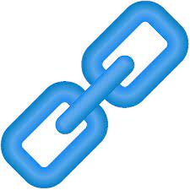
LINKS:

Slide 12
ruTHANK YOU

